Slide 1

Analyzing the economic and social impact of IPL
Resume project challenge #15 conducted by Codebasics
Presented by Ishaa Abdul
Notes:
Hey guys! My name is ishaa abdul and today I will be presenting my Data analysis project which was part of the resume project challenge #14 conducted by codebasics.
"Lio, a leading telecom provider in India, is planning a strategic merger with Jotstar, one of the country’s top streaming platforms. This partnership aims to combine LioCinema’s extensive subscriber base with Jotstar’s diverse content library, setting the stage for a powerful OTT platform."
"To ensure a smooth and successful transition, Lio’s management needs to analyze key aspects of both platforms’ performance over the past year—from January to November 2024. This includes understanding content consumption patterns, subscriber growth trends, inactivity behavior, as well as upgrade and downgrade patterns."
"As the data analyst at Lio, my role is to uncover critical insights from this data to guide informed decision-making. The ultimate goal is to optimize content strategies and position Lio-Jotstar as India’s leading OTT platform."

Slide 2
Agenda
Problem statement
Goal
Data overview
Primary Insights
Secondary insights & recommendations
Thank you note
Notes:
"Let’s go through the agenda for this presentation.
First, I’ll start with the problem statement, where I’ll explain the background of this project and why this analysis is important.
Next, I’ll talk about our key objective—what we aim to achieve through this study and how it will benefit the merged platform.
Then, I’ll walk you through the data models used in this analysis, giving you a quick overview of the underlying structure.
After that, we’ll dive into the main findings. I’ll first highlight the primary insights, followed by some secondary insights that provide additional depth to our analysis.
Finally, I’ll wrap up with recommendations—suggestions that can help both platforms optimize their strategies and successfully move forward post-merger.
So let’s get started!”

Slide 3
Problem Statement
While the Indian Premier League (IPL) has become a major driver of economic activity—fueling industries such as advertising, broadcasting, e-commerce, and tourism—its growing dependence on sponsorships and advertisements from fantasy sports platforms and pan masala brands has sparked public concern.
With over 50% of IPL advertisements linked to such sectors, there is increasing scrutiny over the league’s role in promoting potentially harmful behaviors and products. This raises a critical need to explore not just the IPL’s commercial success, but also the ethical and social implications of its advertising model.
Notes:
Lio, a leading telecom provider in India, is planning a strategic merger with Jotstar, one of the country’s top streaming platforms. This partnership aims to combine LioCinema’s extensive subscriber base with Jotstar’s diverse content library, setting the stage for a powerful OTT platform."
"To ensure a smooth and successful transition, Lio’s management needs to analyze key aspects of both platforms’ performance over the past year—from January to November 2024. This includes understanding content consumption patterns, subscriber growth trends, inactivity behavior, as well as upgrade and downgrade patterns."
"As the data analyst at Lio, my role is to uncover critical insights from this data to guide informed decision-making. The ultimate goal is to optimize content strategies and position Lio-Jotstar as India’s leading OTT platform.

Slide 4
Goal
Analyze the economic footprint of IPL 2025 across industries.
Examine advertising trends, particularly the dominance of fantasy gaming and pan masala brands.
Assess social and public health concerns associated with these advertisements.
Capture public sentiment and expert perspectives on IPL advertising.
Propose recommendations for responsible and ethical advertising during major sporting events.
Notes:
The primary goal of this analysis is to provide Lio’s management with data-driven insights that will help in making strategic decisions post-merger."
"We aim to understand platform performance and user behavior, including trends in content consumption, subscriber growth, and inactivity. Additionally, we analyze upgrade and downgrade patterns to optimize customer retention and revenue generation."
"By assessing revenue impact and profitability, we can shape an effective content and pricing strategy, ensuring Lio-Jotstar becomes a market leader in India’s OTT industry."

Slide 5
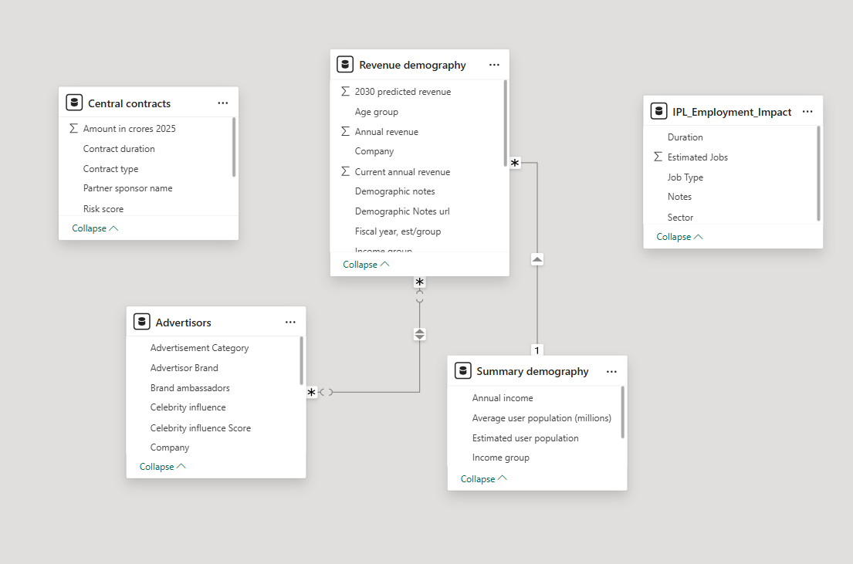
Data overview
Revenue demography- Summary demography (income group)
Revenue demography- Advertisers (Company)
Notes:
Now, let’s take a look at the data model.
The subscriber tables for Lio and Jotstar have been merged into one, ensuring a unified view of the user base. Similarly, the content tables have also been consolidated to give a holistic view of the combined library.
For content consumption, instead of keeping raw data, it has been transformed into a ‘content consumption grouped’ table. This allows us to track total watch hours per user, regardless of the device they used.
Additionally, a date table has been created, which establishes a one-to-many relationship with other fact tables, ensuring smooth time-based analysis across different metrics.”

Slide 6
Primary Analysis
Q1. Total revenue from contracts by %
What is the total revenue generated by IPL from Central contracts in the year 2025? List the revenue contributors by %.

Slide 7
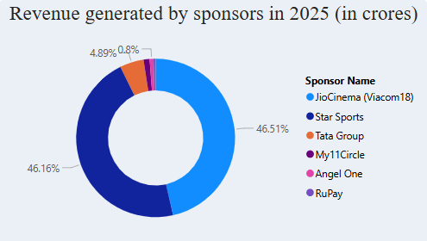
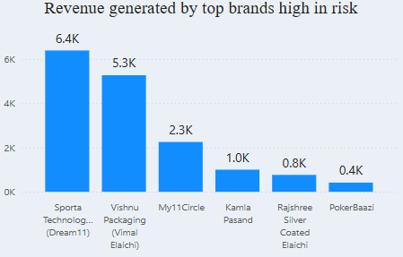
Primary Analysis
Approximately 47% of the total advertising revenue for IPL 2025 is generated from Jio Cinema, with Star Sports contributing an equal 47% share, highlighting the dominance of both digital and traditional broadcasting platforms.
Among the top advertisers this season, Dream11 and Vimal Elaichi lead the pack, collectively accounting for an estimated ₹12,000 crore in revenue.
Notably, both brands are associated with high social and health risk concerns, intensifying the debate around ethical advertising practices during the tournament.
Notes:
Both platforms have shown a steady increase in subscriber count over time.
Jotstar has consistently acquired more subscribers than Lio Cinema, with a significant growth acceleration from June onward.
By November, Jotstar reached 36,997 subscribers, while Lio Cinema remained significantly lower at 4,262 subscribers.
Growth Trend Analysis:
Jotstar: The subscriber base has grown rapidly, particularly from July onwards, with a sharp upward trend visible in the last few months.
Lio Cinema: Growth remains relatively stagnant with only a marginal increase month-over-month.

Slide 8
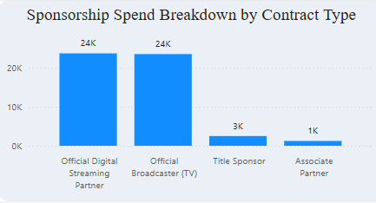
Primary Analysis
Meanwhile, official digital streaming and TV broadcasters each account for ₹24,000 crore in sponsorship spend, dwarfing other contract types like title sponsorship (₹3,000 crore) and associate partnerships (₹1,000 crore), reflecting the dominant commercial weight of media rights in IPL’s revenue ecosystem.
Notes:
Both platforms have shown a steady increase in subscriber count over time.
Jotstar has consistently acquired more subscribers than Lio Cinema, with a significant growth acceleration from June onward.
By November, Jotstar reached 36,997 subscribers, while Lio Cinema remained significantly lower at 4,262 subscribers.
Growth Trend Analysis:
Jotstar: The subscriber base has grown rapidly, particularly from July onwards, with a sharp upward trend visible in the last few months.
Lio Cinema: Growth remains relatively stagnant with only a marginal increase month-over-month.

Slide 9
Primary Analysis
Q2. Projected revenue till 2030
What is projected CAGR until 2030 for the top 5 companies with a high health/social risk index?

Slide 10
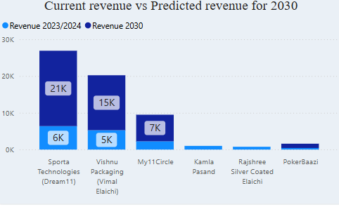
Primary Analysis
Brands like Dream11 and Vimal Elaichi are projected to see significant revenue growth by 2030, rising from ₹6,000 crore to ₹21,000 crore and ₹5,000 crore to ₹15,000 crore respectively—despite both being linked to high social and health risks.
Followed by My11Circle which shows a projected revenue of 7k crores.
Notes:
The user demographics analysis shows that Jotstar's largest subscriber base comes from the 25-34 age group, with nearly 20,000 users. In contrast, Lio Cinema has the highest number of subscribers in the 18-24 age group, with an estimated 80,000 users.
When looking at paid user distribution, both platforms see the highest number of paying subscribers in the 25-34 age group. This suggests that users within this age bracket are more likely to opt for a paid subscription across both OTT platforms.

Slide 11
Primary Analysis
Q3. Impact on the public
Estimate the total population being negatively impacted by these high-risk brands (both pan-masala and betting apps).

Slide 12
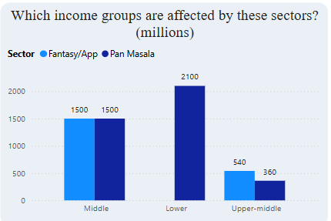
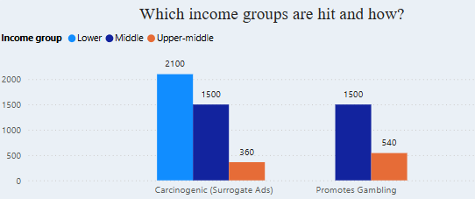
Primary Analysis
Fantasy apps and pan masala ads have a broad and concerning impact across income groups, with the middle-income segment affected most equally by both (1,500 million each).
However, lower-income groups bear the brunt of pan masala exposure (2,100 million), while fantasy apps predominantly influence both middle (1,500 million) and upper-middle (540 million) groups.
The health and social implications are stark: carcinogenic surrogate ads impact over 3,960 million people, mostly from lower and middle-income brackets, while gambling-related promotions disproportionately affect the middle (1,500 million) and upper-middle (540 million) classes.
Notes:
Now, looking at the content type breakdown—50% of Jotstar’s library consists of movies, followed by series, whereas Lio has a much higher concentration of movies at 72%, with very limited sports content. In comparison, Jotstar dedicates 15% of its library to sports, making it a stronger player in this category.

Slide 13
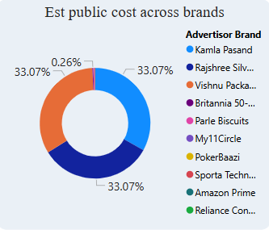
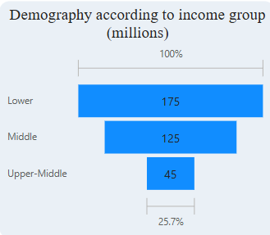
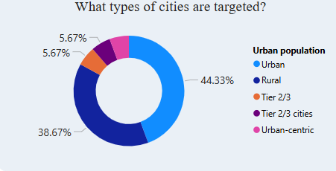
Primary Analysis
These high-risk brands have significantly impacted the public, leading to health issues and financial burdens, with losses reaching up to 33% each. This impact is largely attributed to Kamla Pasand, Rajshree, and Vishnu Packaging.
The associated health costs are estimated at ₹177,000 crore per brand.
The primary demographic affected includes individuals from lower-income groups (earning less than ₹3 lakh annually), followed by the middle-income segment (earning ₹3–7 lakh annually).
The main target audience for these brands is urban residents, followed by rural populations, together making up 82% of the consumer base.
Notes:
Now, looking at the content type breakdown—50% of Jotstar’s library consists of movies, followed by series, whereas Lio has a much higher concentration of movies at 72%, with very limited sports content. In comparison, Jotstar dedicates 15% of its library to sports, making it a stronger player in this category.

Slide 14
Primary Analysis
Q4.Socio-economic impact
List the top 5 celebrities who have been promoting the brands with high social risk in 2025 and analyze from the internet, how has employment been created, what is the tax collection from these revenues.

Slide 15
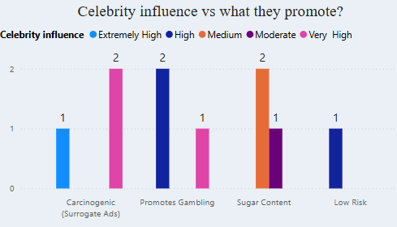
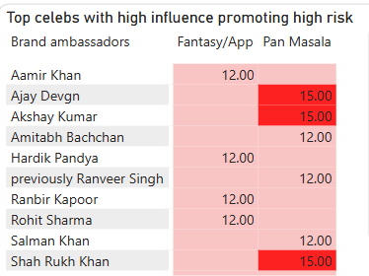
Primary Analysis
Celebrities with significant influence have been observed endorsing brands associated with cancer and gambling. Approximately 60% of these celebrities promote high-risk brands.
By categorizing advertisements into fantasy apps and pan masala, we have developed a scoring system based on the product of celebrity influence and health risk.
The celebrities with the highest scores, primarily Ajay Devgn, Akshay Kumar, and Shah Rukh Khan, are known for promoting tobacco consumption.
Meanwhile, figures like Aamir Khan and Amitabh Bachchan are endorsing gambling, particularly in the context of the IPL.
Notes:
• City Tier Analysis:
Tier 1 cities have the highest total watch time, with Jotstar dominating in this segment.
Tier 2 and Tier 3 cities show a more balanced watch time distribution between the two platforms.

Slide 16
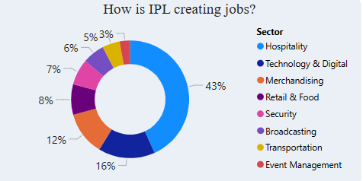
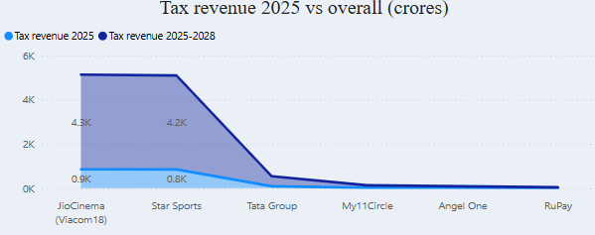
Primary Analysis
IPL has been creating seasonal employment as well majorly in the hospitality and digital sector accounting to 43% in hospitality and 16% in digital.
Other areas where employment is created is merchandising, food, security, transport etc.
The tax collection for the year 2025 is the highest from Jio Cinema accounting to approx 1000crores with a projection of 4.3k crores overall from 2025-2028.
Star Sports is next highest with current tax collection of 0.8k Crores and 4.2k crores till 2028.
Notes:
• City Tier Analysis:
Tier 1 cities have the highest total watch time, with Jotstar dominating in this segment.
Tier 2 and Tier 3 cities show a more balanced watch time distribution between the two platforms.

Slide 17
Recommendations
1. Propose a framework for increasing the economic benefits of IPL while minimizing potential negative social impacts.
A good percentage of the revenue can be invested in local infrastructure, prioritizing small businesses.
Employment can be created more by tying up with institutes for training youth for multiple sectors like event management, digital marketing, logistics, social media management etc. This also gives the youth some good work experience.
2.Health concerns while preserving revenue. Design a hypothetical "Responsible Advertising Policy" for IPL that addresses
Don’t promote brands that are risky in terms of health and socially. Promote anti-gambling and anti-tobacco consumption through the media which will create a good impact thus reducing public health costs especially amongst the rural sector.
Advocate the repercussions of gambling, instead promote good social practices like mutual funds probably.
Advocate social and health lifestyle changes. Try partnering up with fitness brands and health brands.

Slide 18
Recommendations
3.Recommend strategies for players to evaluate and select endorsement deals based on social impact considerations.
Players should evaluate whether the factors promoted by these brands are something that they personally are willing to advocate. For example- strength, integrity, hardwork, honesty, growth etc
Only endorse those brands if its aim is to improve lives.
Investigate the brand’s company’s records, if they’re environmentally sustainable, financially reliable and promote good values.
Come up with exit clauses if those brands are involved in scandals socially or morally.

Slide 19
Thank you!

